Slide 1
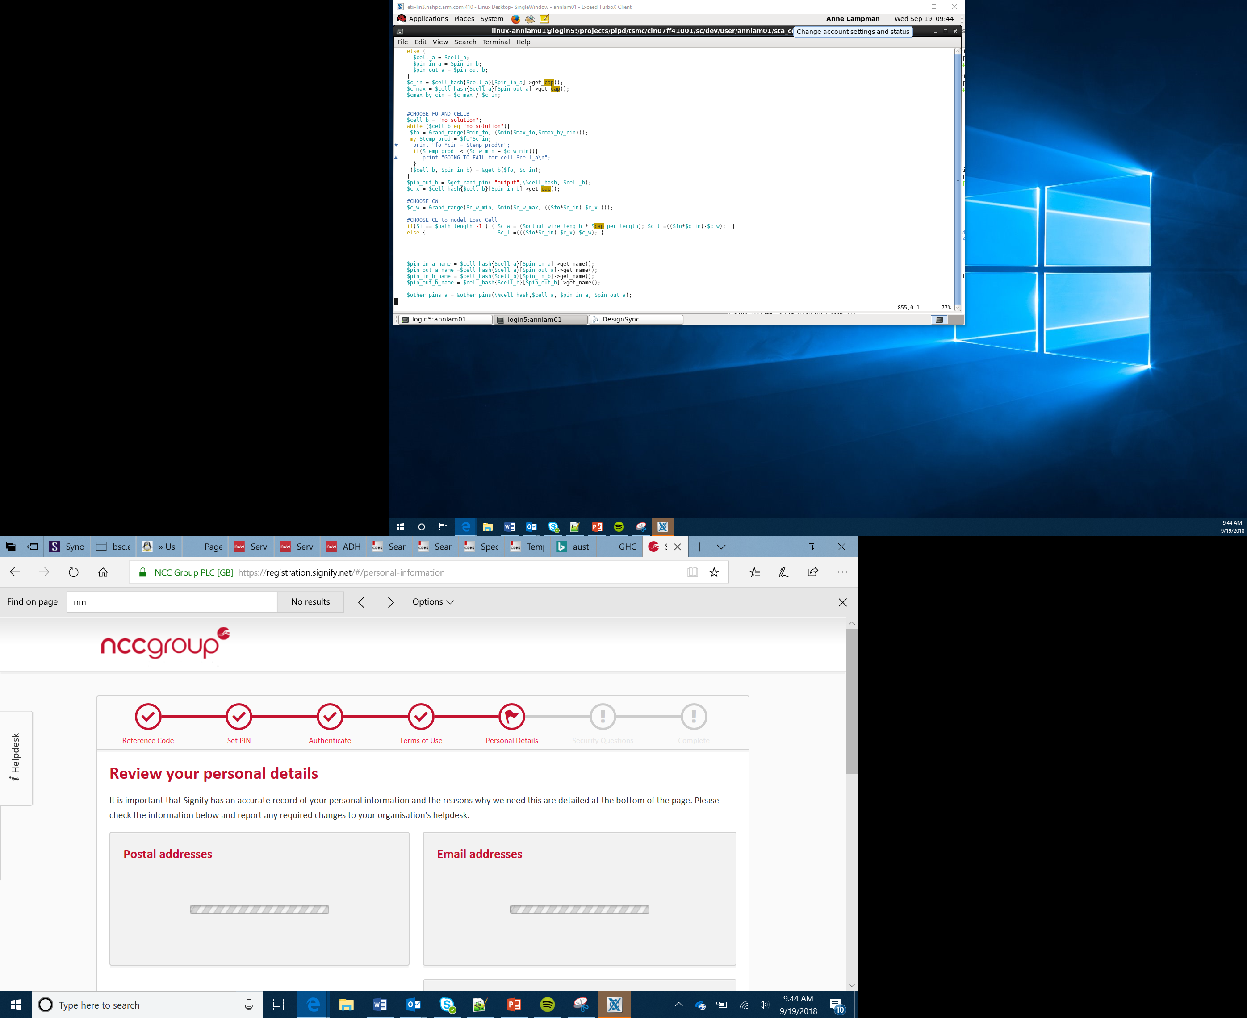

Binary and LEDs
Lesson 4

Slide 2
Number Systems
Computers use a different number system to the one that we are used to
How many different digits are there in our normal number system?
Notes:
Ask learners to think about how many different numbers can be represent with one digit. Some will say 9 as they will forget that 0 is a number. We can have 10 different numbers before two digits are required.

Slide 3
Denary
Our normal number system is denary
This is a base 10 number system as we can have 10 different numbers before we need another digit
The ten different numbers are 0 1 2 3 4 5 6 7 8 9
Computers are made of up lots of electrical circuits
An electrical circuit has two different states – On and Off
For this reason we need to use a different number system that has two bases

Slide 4
Binary
The binary number system is a base 2 number system
It has two different numbers 1 and 0 or On and Off
As humans normally work with denary numbers it is useful to be able to convert numbers between the two different systems

Slide 5
Binary to Denary Conversion Part 1
We are going to learn how to convert the number 1011 from binary to denary
Firstly, place the binary number into the bottom row in the table
You should then add denary numbers to the top row
Starting with the right hand side write 1
Every time you move left a position the number should double so the next cell will contain a 2
Continue this process until all of the cells are complete
1 | 0 | 1 | 1
8 | 4 | 2 | 1
1 | 0 | 1 | 1

Slide 6
Binary to Denary Conversion Part 2
You should now have the following table
You then need to work out the totals for each cell. You have:
1×8 = 8
0×4 = 0
1×2 = 2
1×1 = 1
Finally, you should add the totals together. 8+0+2+1=11
1011 in binary is therefore 11 in denary.
8 | 4 | 2 | 1
1 | 0 | 1 | 1

Slide 7
Denary to Binary Conversion Part 1
You are now going to convert the denary number 14 into binary
To do this you divide the number by two and write the remainder:
14/2 = 7 remainder 0
7/2 = 3 remainder 1
3/2 = 1 remainder 1
1/2 = 0 remainder 1
Finally, write down the remainders starting with the number at the bottom
1110
14 in denary is therefore 1110 in binary

Slide 8
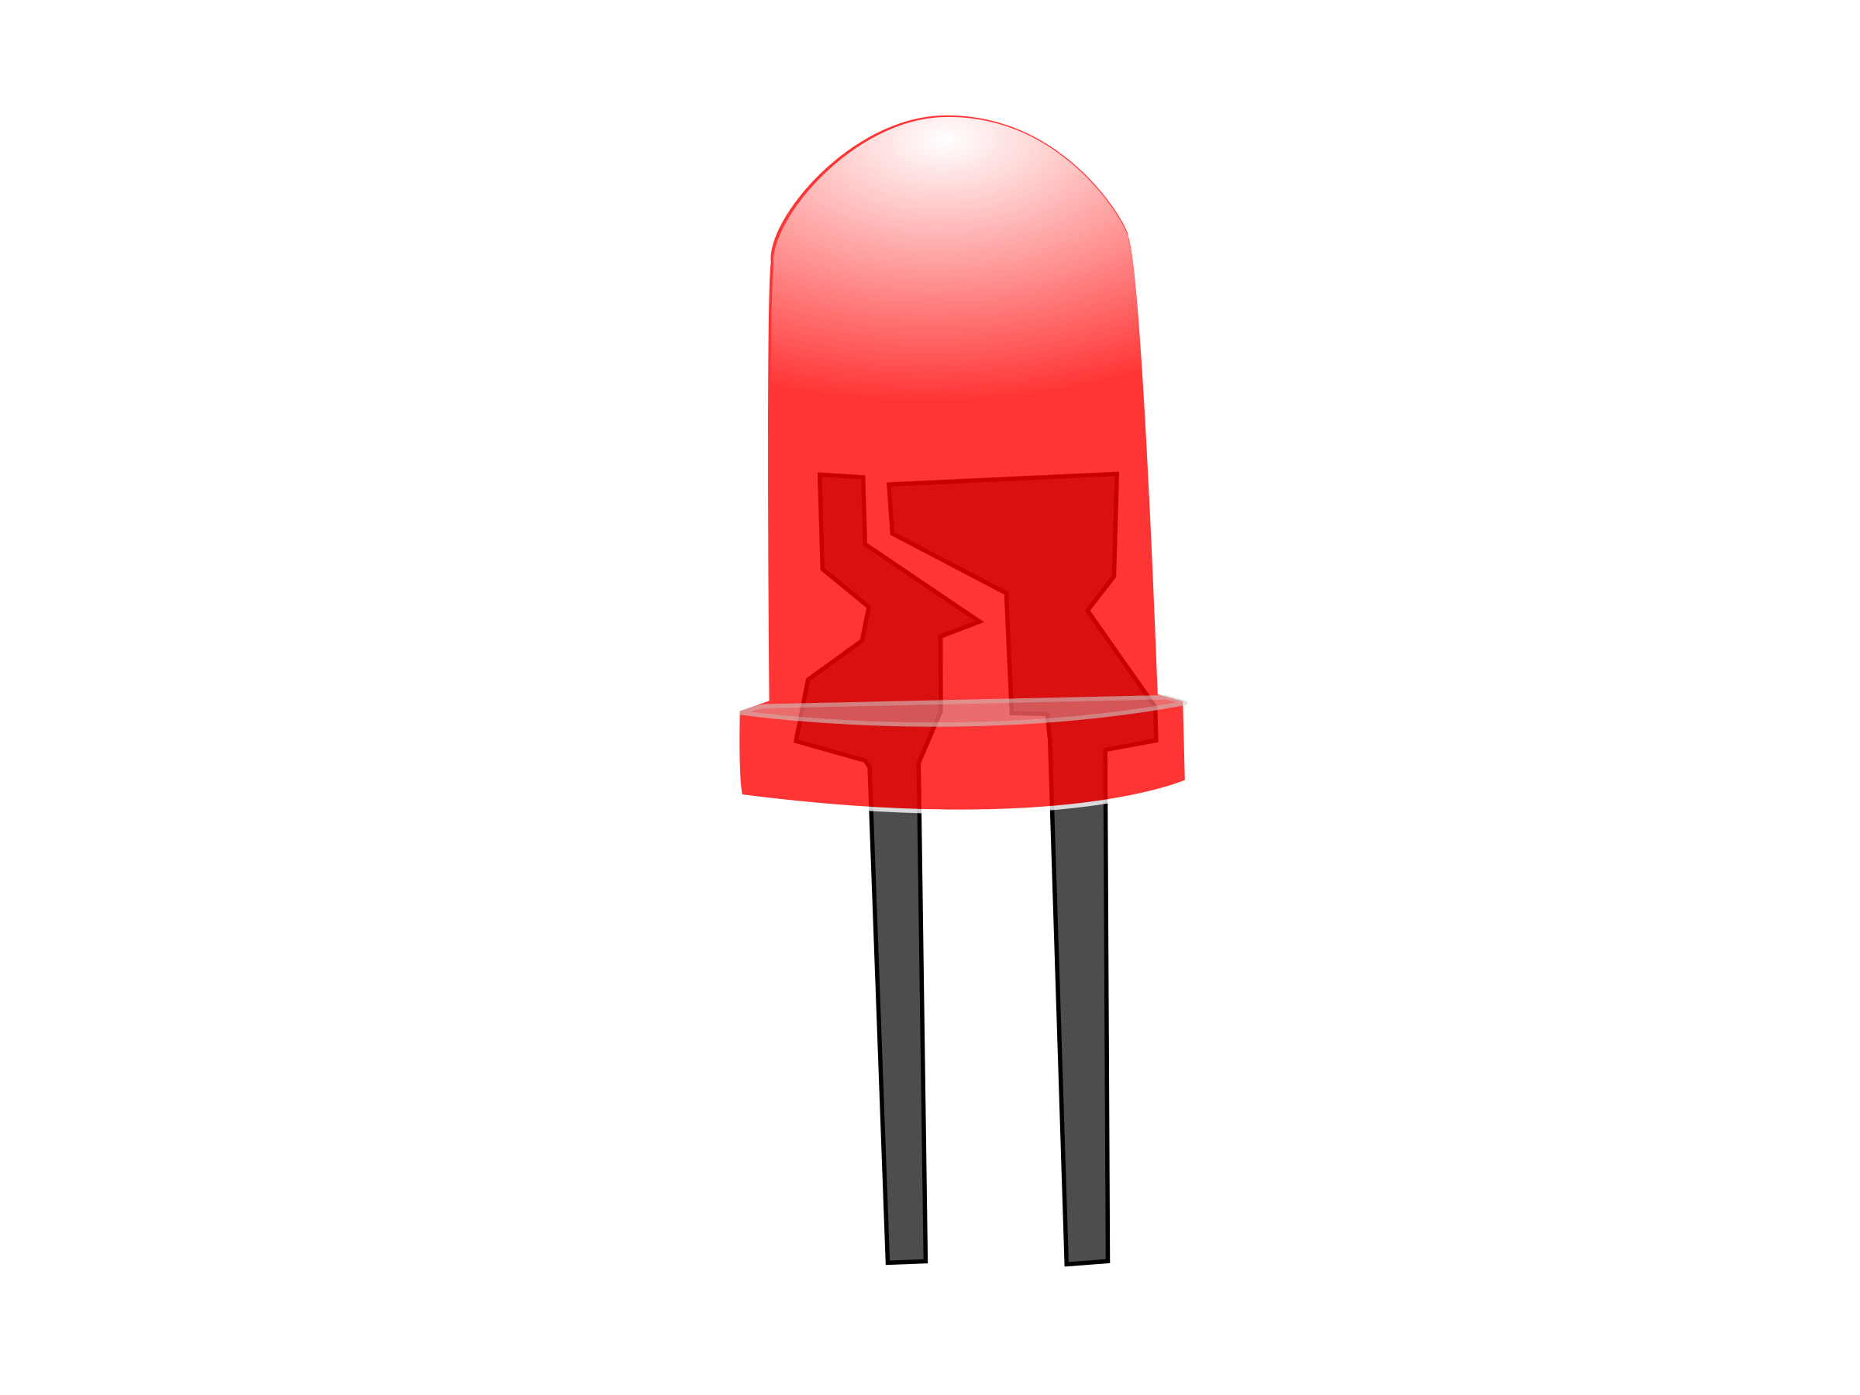
LEDs
The screen on the micro:bit is made of LEDs
LED stands for light emitting diode
When you pass electricity through an LED it lights up
The more electricity you pass through it the brighter it will be
To dim the LED you reduce the amount of electricity passing through it
You can control the brightness on an LED on the micro:bit

Slide 9
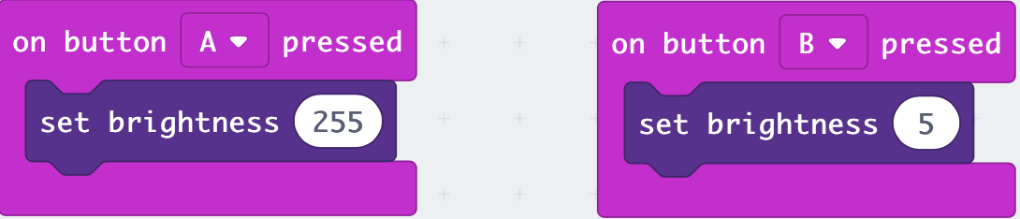
Changing the brightness on the micro:bit LEDs
The code below sets the brightness to 255 when Button A button is pressed – this is the maximum brightness for the LED on the microbit
To represent 255 8 bits are required in binary
In computer science we call 8 bits a byte
When Button B is pressed the LED is set to 5 which isn’t very bright
You should write this program on your micro:bit. Can you add additional blocks of code so that is acts as a dimmer switch?
Notes:
Demonstrate the creation of the code on MakeCode. The brightness option can be found on the LED section and then more.

